Slide 1

Power Consumption & System Monitoring
- Pow App

Slide 2

Table of contents
02
01
03
04
TECHNOLOGY USED
ABSTRACT
IMPLEMENTATION
RELEVANCY TO OS
05
CODE SNIPPET AND OUTPUT

Slide 3

01
ABSTRACT
Our project is a GUI application that monitors a computer's power consumption and system specifications using the Psutil library and obtains information about running processes on the system. It is flexible and easy to use as it works both on macOS and Windows.

Slide 4
02
Technology Used
Python
100%
Tkinter
50%
Psutil
80%
Platform
20%
Os (for Mac)
10%

Slide 5
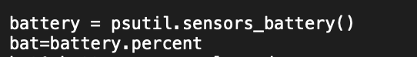
Implementation
First Section
Battery percentage
Plugged in or not

Slide 6
Second Section
CPU Usage
Ram Usage
Ram Capacity

Slide 7
---- Built GUI with Tkinter ----
Third Section
Operating System
Machine Name
Processor Type

Slide 8
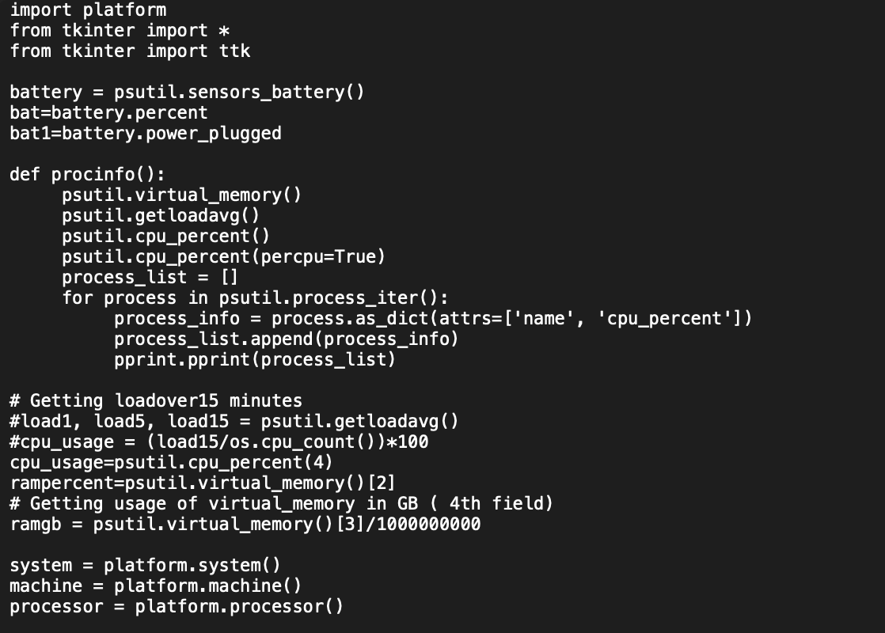
Code Snippet

Slide 9
Output (MacOS)

Slide 10
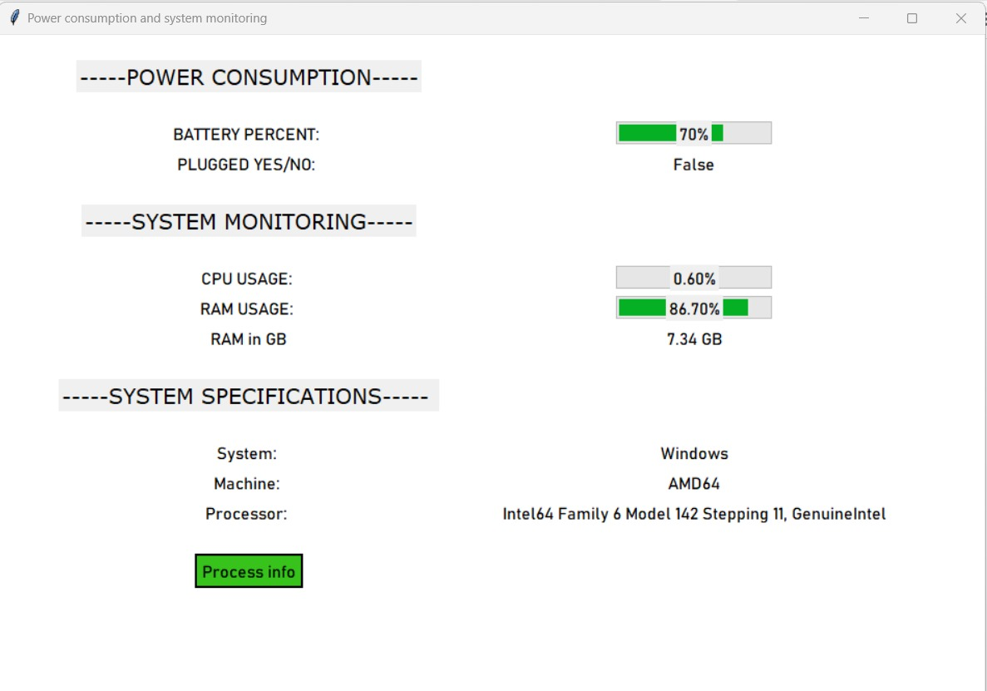
Output (Windows)

Slide 11
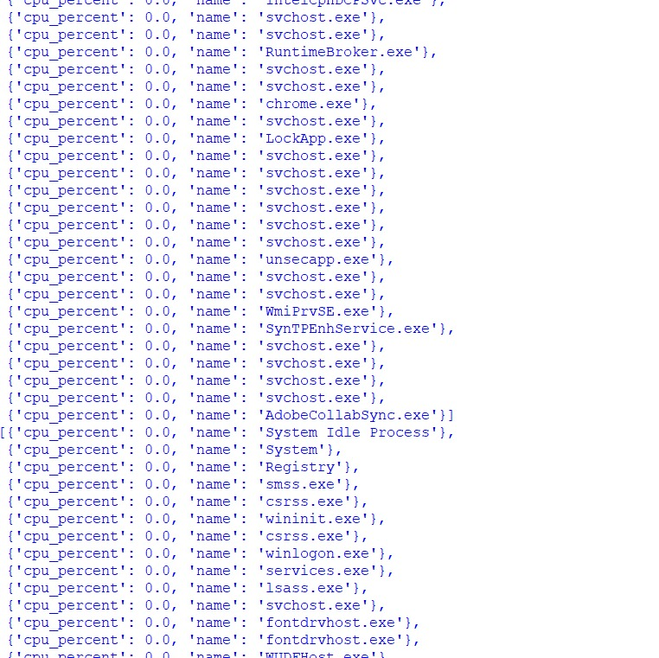
Output(process Information)

Slide 12
Relevancy to OS?
System monitoring and maintaining the health of os
Psutil library
Platform module

Slide 13
Relevancy to OS?

Slide 14
Team Details
Perla Sree Neha
CH.EN.U4CSE21147
Harine
CH.EN.U4CSE21121
Vyshnavi
CH.EN.U4CSE21180

Slide 15



THANK YOU

